Slide 1
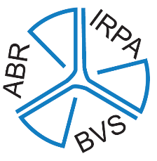
BVS- ABR Workshop @ RICOMET 2018 Antwerp, Belgium June 13th 2018
How do radiation protection associations engage with society?
1st IRPA Workshop on “Communication and public engagement of IRPA Societies”

Slide 2
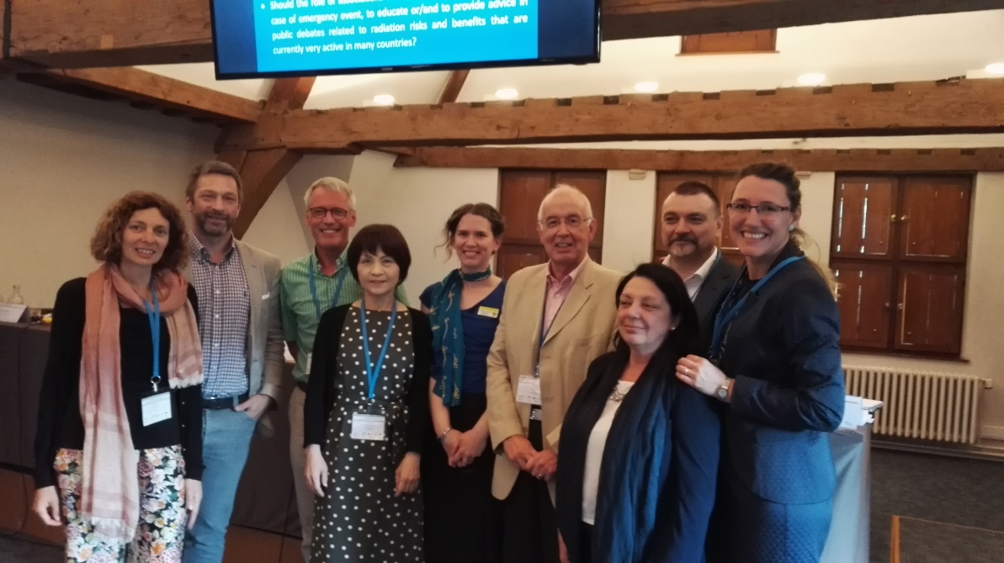
The first International Radiation Protection Association (IRPA) regional workshop on ‘Communication and public engagement of IRPA Societies’ to collect good practices, explore ideas and identify needs for inclusion in the
‘IRPA guiding principles for communicating and engagement with the public.’
@ RICOMET 2018 - Antwerp, Belgium
1st IRPA Workshop on “Communication and public engagement of IRPA Societies”

Slide 3
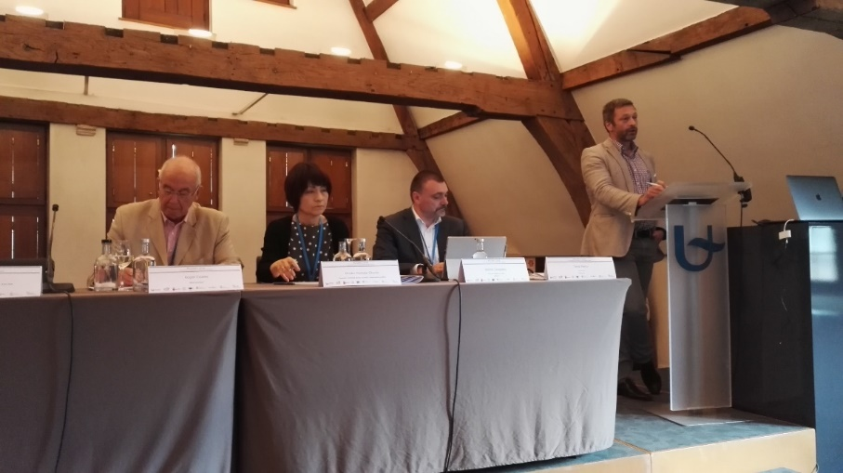
Workshop Program
Chair’s welcome and introduction of the program and the panel, Michel Ceuppens
Welcome by BVS-ABR President, Michel Sonck
Key note speech of Hiroko Yoshida-Ohuchi, President Technical Group on Public Understanding – IRPA
Overview IRPA Workshop @ IRPA 2018 in The Hague, June 4-8 by Roger Coates, IRPA President
Panel presentation of different current national practices by national Radioprotection Associations from the Netherlands, Italy, UK, Spain and Belgium
Visualization through question and image of the need for improving communication, moderated by Tanja Perko
1st IRPA Workshop on “Communication and public engagement of IRPA Societies”

Slide 4
To start with, some considerations
beware for the interchangeably usage from the terms society and association
BVS-ABR President, Michel Sonck, expresses the need for clear communication with ALL stakeholders!
Communications is currently mainly aimed at experts and to a very limited extent, suitable for a general public e.g. technical terms and units such as effective or collective dose, (man)-sievert, etc.
In order to open up communication to specific stakeholders, adapted forms of communication need to be developed.
1st IRPA Workshop on “Communication and public engagement of IRPA Societies”

Slide 5
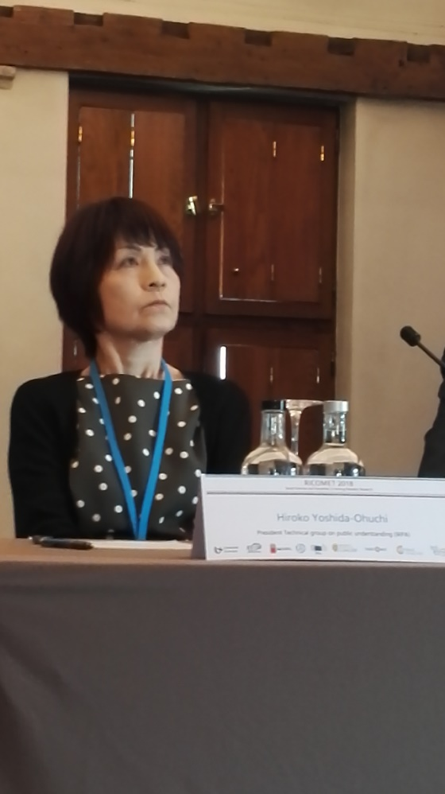
Hiroko Yoshide-Ohuchi President Technical Group on Public Understanding – IRPA
IRPA website provides good practises e.g. a glossary, a public platform for communication,etc…
Aim of the TG is to support the Associated Societies and individual professionals to better understand the challenges of communication.
Objectives of the TG
update the IRPA webpage
Review of the existing literature and recommendations. TG wants to provide user friendly publications.
develop soft skills tools pack
develop methodology and protocol to engage with IRPA
1st IRPA Workshop on “Communication and public engagement of IRPA Societies”

Slide 6
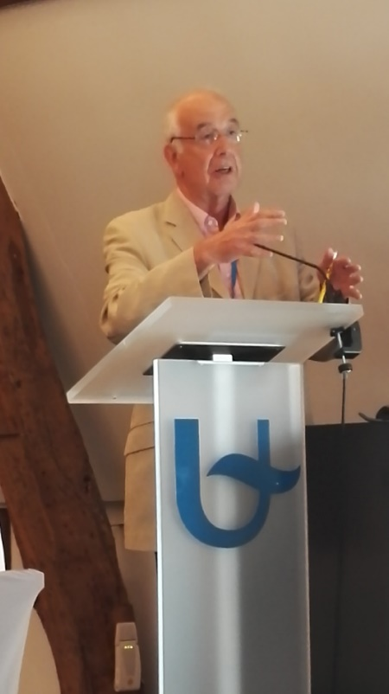
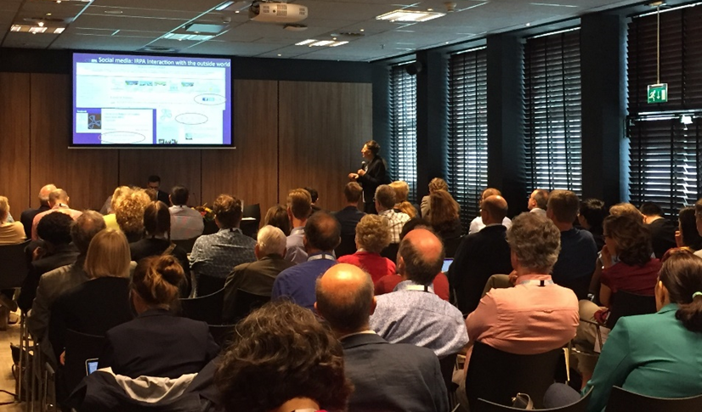
Roger Coates IRPA President
Overview IRPA Workshop @ IRPA 2018 in The Hague, June 4-8
50 à 60 participants
1st IRPA Workshop on “Communication and public engagement of IRPA Societies”

Slide 7
Presentations
Work of the IRPA TG on Public Understanding of Radiation Risk and Towards Guiding Principles for IRPA Communication and Engagement with the Public, Tanja Perko (Belgian Nuclear Research Centre SCK∙CEN)
Experiences of engaging with 'non-RP specialist' cohorts (such as the public, the media and politicians) with regards to the UK Nuclear New Build Programmes, Pete Bryant (UK Society for Radiological Protection)
Engaging with School Children – Experiences from the SRP Schools Outreach Programme, Pete Cole (University of Liverpool)
1st IRPA Workshop on “Communication and public engagement of IRPA Societies”

Slide 8
Results : Panel Discussion and Q+A
In communicating and engaging with the public we must be careful not to show any bias towards a certain sector e.g. be perceived as pro-nuclear.
We should be engaging with a variety NGOs e.g. Greenpeace, Friends of the Earth, and local community groups.
Experience from the Spanish Society’s public website shows that out of 200 questions received from the public only one related to concerns about nuclear power. Most questions were concerned with medical exposures.
Beware a segmented approach to risk communication in different sectors. A consistent and unbiased approach to communicating radiation risks in all sectors is recommended.
It was noted that the final IRPA guiding principles must be applicable in different countries around the world with different cultures and we must be cognisant that some countries may well have very small budgets available for implementing recommendations for best practice, and more pressing priorities.
We must explore the scope for developing collaborations with a full range of industries and NGOs. This may facilitate engagement work by sharing costs or garnering funding.
IRPA President concluded by saying that the aim/mission of the TG should be to promote a better understanding within the public cohort so that when debates are ongoing on nuclear power or other radiation-related topics, the public have a more robust knowledge base on which they can make their value judgements.
1st IRPA Workshop on “Communication and public engagement of IRPA Societies”

Slide 9
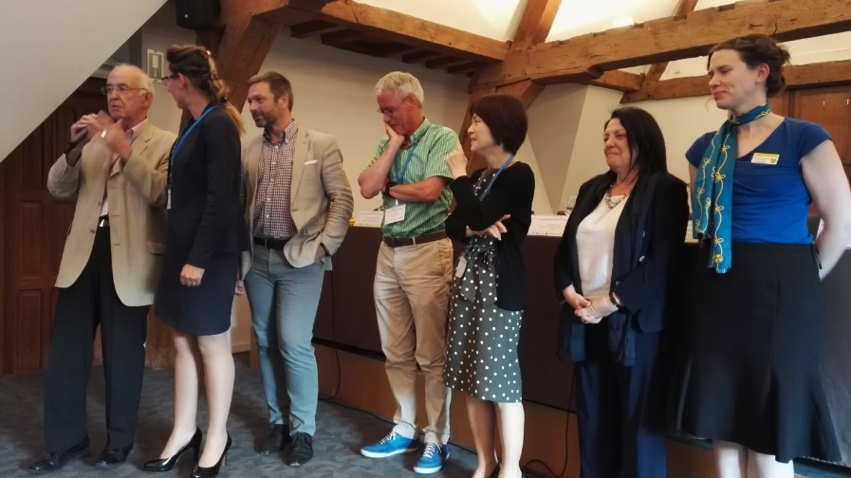
Panel members BVS-ABR Workshop@RICOMET 2018
Paul van Rooijen - The Netherlands
Dutch Society for Radiation Protection, NVS
Marie Claire Cantone - Italy
Italian Association of Radiation Protection, AIRP
Jennifer Humphries - UK
Society for Radiological Protection, SRP
Michel Sonck - Belgium
Belgian Society for Radiation Protection, BVS-ABR
Eduardo Gallego - Spain → spoken message and PowerPoint presentation
Sociedad Española de Protección Radiológica, SEPR
1st IRPA Workshop on “Communication and public engagement of IRPA Societies”

Slide 10
Currently applied good practices
for experts, professionals
provide information through website, newsletter, magazine,…
organization of scientific meetings, training days
in Italy: large emphasis on medical, as well on ethics → ethics as basis of RP and as basis for communication
for general public
web-page for visitors to ask questions → little used in Belgium, in Spain more widely used, especially for medical issues
also in Italy: a significant attention to the aspect of medical exposure → they provide small booklets in very basic language for medical risk
Italy: a book to go to communities, to prepare stakeholders for emergency situations
UK has a lot of educational and demonstration material for schoolchildren’s events and science fairs e.g. posters, all kinds of games, pencils,etc… to let the children and parents get acquainted with radioprotection in a playful manner
1st IRPA Workshop on “Communication and public engagement of IRPA Societies”

Slide 11
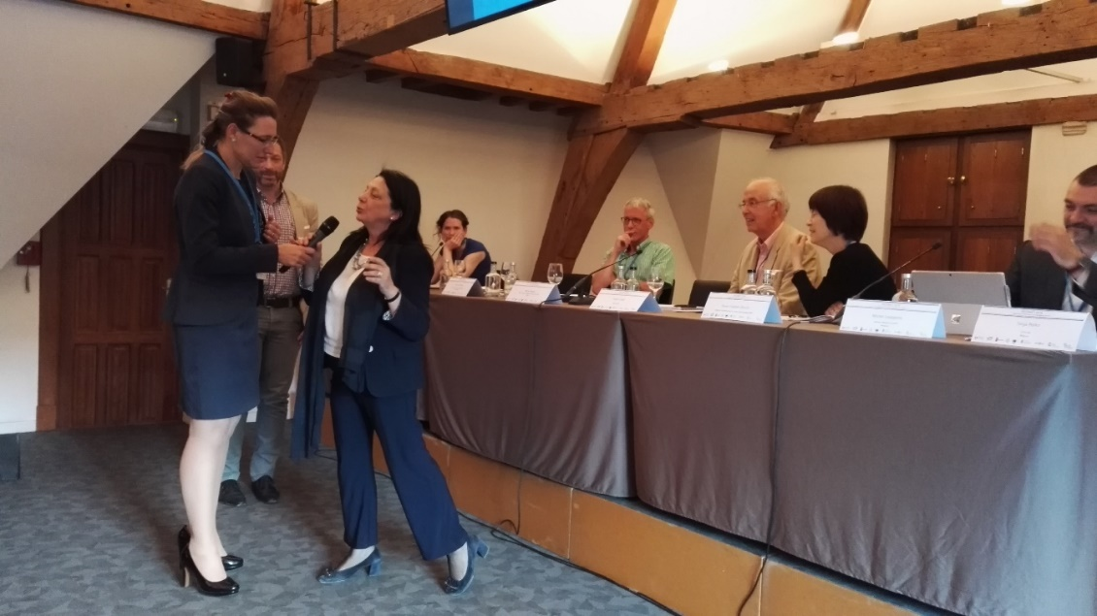
Panel discussion
Due to time constraints, the Q & A-discussion with the participants, is replaced by asking the panel members to visualize the need for improving communication. This is moderated by Tanja Perko.
the representatives of the associations have to indicate how they would position their current work in the area of ​​stakeholder communication
all representatives indicate that much improvement is needed, this through
government support
an active communication team within the national associations
financial support
for sure, IRPA plays a pioneering role to assist national associations in this perspective

Slide 12
Points of improvement
Most associations are not financially independent, the resources come from membership fees, they have no financial means to start new communication channels, specifically aimed at certain stakeholder groups → financial support needed
associations rely completely on volunteers → time to put into the association is limited, in addition to their main activities
need for training days on how to better communicate
need for clear explanation on riskperception
focus on better visibility for children and schools
web-page for visitors to ask questions → too little used => increase visibility
In emergency : how to prepare the difference part in preparedness. Pepared a book to go to communities
development of adapted forms of communication
1st IRPA Workshop on “Communication and public engagement of IRPA Societies”

Slide 13
Unlimited list of discussion issues
What is the role related to public information, communication and transparency of different associations towards the public?
How to ensure recognition of associations as the stakeholder in radiation protection issues?
What are challenges that associations are faced with and what are good practices in communication and stakeholder engagement?
How to share RP knowledge and how to put it in the best possible perspective for the public?
Should the role of associations be limited to communication in a case of emergency event, to educate or/and to provide advice in public debates related to radiation risks and benefits that are currently very active in many countries?
1st IRPA Workshop on “Communication and public engagement of IRPA Societies”

